Slide 1

HOTEL MANAGEMENT SYSTEM
Muniza mukhtar(9)
Tayyaba kanwal(15)
Ramiz Hussain(16)

Slide 2
Introduction
The Hotel Management System is a web-based platform designed to manage hotel operations efficiently.
It handles room bookings, guest check-ins, payments, and staff activities in one system.
Simple hotel booking website with content management system. Users can book rooms for specific dates. Admin can create, update, and delete room details. Admin can manage everything in the app.

Slide 3
Project Objective
Replace manual processes and paperwork
Let guests book rooms online anytime
Help staff manage rooms, bookings, and payments
Provide a central dashboard for hotel managers
Keep all guest data safe and well-organized

Slide 4
Real-life Applications
Online room booking
Automated billing and payments
Staff task management
Real-time reports and analytics
Guest data management
Fast check-in/check-out
Feedback system
Multi-branch control

Slide 5
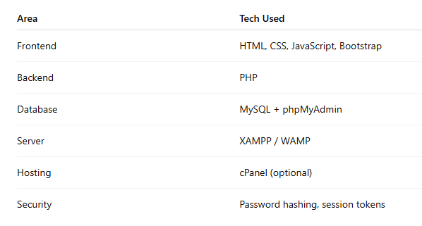
Tools & Technologies

Slide 6
Key Feature
User & admin login panels
Real-time room booking
Booking ID with email confirmation
Role-based staff access
Manage rooms and availability
Filtered booking management
Secure login & password protection
Room showcase with images
Facility highlights (Wi-Fi, Gym, etc.)
Report generation

Slide 7
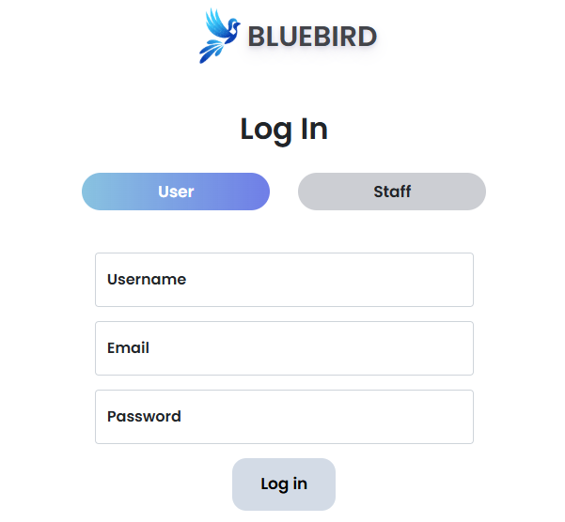
Login page for user

Slide 8
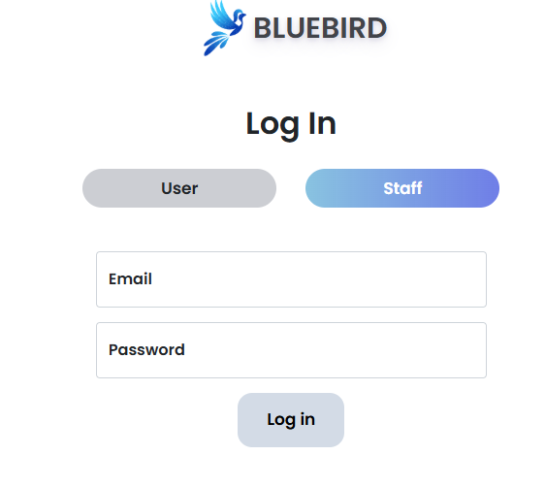
Login page for staff

Slide 9
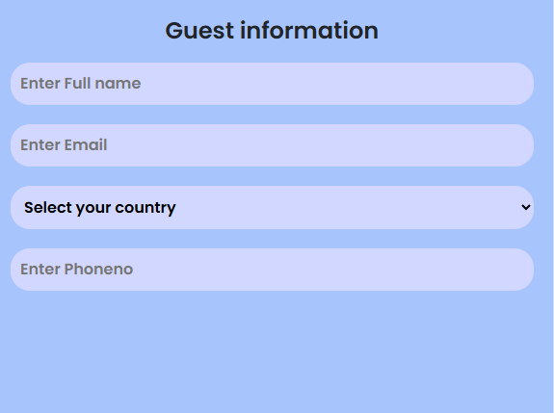
Guest information

Slide 10
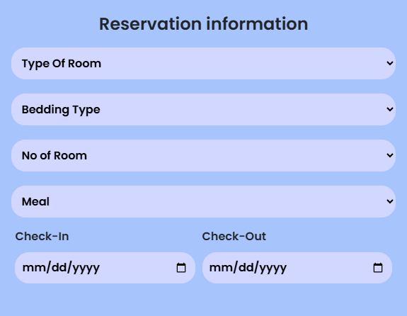
Reservation information

Slide 11
Future Scope
Online payments
OTP & email verification
Booking history for users
Live chat or chatbot support
Multi-language support

Slide 12
Conclusion
The Bluebird Hotel Management System is:
User-friend,Secure,Efficient
Reduces manual work and errors
Enhances guest experience and satisfaction
Provides secure and centralized data management

Slide 13


